Slide 1
DESIGN AND FABRICATION OF FOUR WHEEL DRIVE TROLLEY

Slide 2
ABSTRACT
Trolley is the device used for carrying load or to transport the material from one point to another. For different types of application various types of trollies are available in the market. Depending upon the specific use the one will select the trolley, but it is limited to do a specific work. To overcome this problem, a new troPey was designed which could be used for multipurpose. There are many types of trolley available in the marketfor various fields likeaéport, shopping malls, industries, hOSpitdls etc. to carry the heavy or light loads. This paper cOntdiRs the development of trolley, which includes design on the basis of creativity skills and fabrication, which can be used for more than one type of task. The trolley designed is the integration of a@ort troPey and shoppingmall trolley. One more advantageous feature added to thedesign wasa motorized wheel which reduces the human effort forcarrying of load and also it can be operated manually if requéed.

Slide 3
INTRODUCTION
A trolley is small transport device used to move significant load from one place to another. In most of the industries hand trolleys normally used to transport finished product or raw materials. Differing kinds of trolley exist and alsothe type used is comm onlychosensupportedwhatkind of material it'll move.A trolley is an object with wheels that you use to transportheavy things such as shoppingor luggagesaferuse oftrolleys,they are to bepushedforwardandshouldnot be used on loose or rough surfaces where possible, unless it features pneumatic wheels. And wheeled mechanism from which a hoist is suspended to provide horizontal motion of the hoist along a beam and bridge rail.Alwayspush a trolley forward, and don't pull the trolley. Position the trolley as close to the items as possible. Use the foot brakes while loading, if the trolley has them. Use a semi-squatposition to load the items.

Slide 4
CONSTRUCTION
The trolley was constructed in the welding workshop where marking and cutting was the first approach in the construction. The cutting of the steel galvanized pipe and plate will be used for fabrication. Metal welding was the next step, all parts were joined together using a welding machine and an electrode. When designing a trolley, it's important to consider the comfort and protection of the person who will be pulling it. For example, a trolley can have a braking mechanism and a suspension system to help absorb jerks when moving it on stairs. wheeled mechanism irom which a hoist is suspendedto provide horizontal motion of the hoist along a beam andbridge rail.beam trolleys areused tolift andtransportheavybuildingmaterials,such as steel beams, concrete blocks, or prefabricated components.

Slide 5
LITERATURE REVIEW1/4
Prof. Mr. Patwegar A. A., Prathamesh Bhosale Renuka Chougule, Varsha Shipekar, Satappa Zambari, Avinash Malekar
Design and Fabrication of Material Handling Trolley
This paper describes the “Design and Fabrication of Material Handling Trolley”. We need to reduce manual efforts of workers for material handling effortlessly. The main purpose of material handling trolley is to ensure that the right amount of material is carefully delivered to the desired destination at the right time and at minimum cost. The main objective was to build a electric vehicle of capable of transporting weight of a material up to 150 kg and capable of travelling to some distance with varying speed. In present work, the focus is given on the time period, comfort, advancement, low cost, and mainly manual work is aimed to be reduced as much as possible. This paper also take into consideration the material used with minimum possible cost

Slide 6
LITERATURE REVIEW2/4
Balabomma Hemanth, Bolligarla Chaitanya Akarsh, Boyidapu Bhanu Sai, Boksu Srinivas, Dr. K.Prasada Rao
FABRICATION OF A TROLLEY IT IS ATTACHED TO A TWO-WHEELER FOR AGRICULTURAL PURPOSES
Modern agricultural practices aim to increase productivity and efficiency. An essential part of this growth is the development of new instruments that enable farmers to do their tasks more effectively. This study describes the design and development of a tram system that can be mounted on a two-wheeler and specifically addresses the requirements of small- and medium-sized farmers engaged in agricultural activities. The tram system will make it easier for farmers to move machinery, tools and produce throughout their fields by enhancing transportation alternatives.Weight capacity, stability, maneuverability, and ease of attachment to a normal two-wheeler were all carefully considered when designing the tram. In the manufacturing process, welded steel and sturdy materials were employed to ensure the trolley's durability and keep the weight manageable for the two-wheeler to carry. Additionally, safety features like reflectors and brake systems were built into the design to guarantee safe operation both during the day and at night. Due to the user-friendly design of the connection mechanism, farmers can rapidly attach and detach the tram from their two-wheeler. This adaptability gives farmers flexibility by enabling them to use the same two-wheeler for a range of jobs.To evaluate the performance of the tram, field testing was done with varied loads and surfaces. The research revealed that the tram greatly boosts the two-Wheeler's carrying capacity, allowing farmers to transport more equipment, seeds, and fertilizer. According to an assessment of the stability of the trolley attachment and its impact on maneuverability, the trolley system maintained a decent balance while not materially compromising the two-Wheeler's handling.

Slide 7
LITERATURE REVIEW3/4
Janmey Panchal, Akib Mansuri, Samir Mansuri and Abhishek Chauhan
Design and Fabrication of Automatic Sensor based Material Handling Vehicle
– In the recent times the need of automation is increasing day by day which helps us to enhance the creation and application of technologies to produce and deliver goods and services with minimal human intervention. The implementation of automative technologies, techniques and processes improve the efficiency, reliability, speed of many activities that were previously performed by humans. Therefore an automatic human following sensor based material handling vehicle is required which decreases the human effort and increases the capacity to finish the work at the small time interval. This research mainly describes the working of ultrasonic sensor attached to the small four wheel trolley cum vehicle which will be run by using renewable source of energy. Also it has been made to help the workers and the frontline workers to carry such materials in this contact less covid era. In this we will also like to explain the combination of the automatic as well as the utility of renewable source of energy to save the energy for future generation and for the welfare of the nature.

Slide 8
LITERATURE REVIEW4/4
Sachin P. Dhavane , Priyanka D. Suryavanshi , Rahul B. Kamble , Renuka K. Gaikwad
Design and Development of Automotive Material Handling Trolley
Transportation of automotive parts within the plant and from one industry to another or from the manufacturing industry to OEMS industries is the basic need of each company. The Timely Delivery and lesser Defective parts during the transport play a major role in controlling the inventory which in turn results in the profitability of the industry. The transported parts are to be used in an assembly line or to be stored as per the future requirements. Therefore, that storage of such parts safely and for the specified duration is done by using different trolleys. The theme of the paper is to showcase the design and manufacturing of material handling trolley used in the automotive industry. In this paper, mainly focusing on a case study involving trolley which is used for storing and transporting the HVC front panels. The main motive is to design trolley with given specific load conditions, to reduce clutter and allow for streamlined picking and handling. The Modeling design is carried out by using Solid Works 2014*64 edition software and analysis of the trolley is performed using Hypermesh 2017 software. The Desired design parameters of the trolley are checked by Analytical Calculations and the Results from the software Analysis. Finally, the Paper empathizes the selection of optimum material, Dimensions, and safety conditions for the Trolley to be manufactured.

Slide 9
WORKING PRINCIPLE
Industrial trolleys work on the principle of amplifying a small physical force to move heavy items. They aredesigned to reduce the need for manual labor, which can help to prevent injuries and accidents. When loading hand trucks, keep your feet clear of the wheels. Do not exceed the manufacturer'sloadratedcdpilcity;readthecdpacityplateonthehdndtruckifyouareunsure. Placethe loadsothatitwillnotslip,shiftorfall;use the straps,if theyareprovided,tosecure theload.Forextremelybulkyorpressurizeditemssuchasgascylinders,straporchaintheitems. If your view is obstructed,ask a spotter to assist in guiding the load Do not wakbackwardwith the hand truck. If your view is obstructed, ask a spotter to assist in guiding the load. Do not walk backwardwith the handtruck,unless goingup stairs or ramps.Whengoingdownan incline, keep the hand truck in ñont of you so that it can becontrolled at all times. Move hand trucks at a wakingpace Store hand trucks with the tongueunder a pallet, shelf, or table.

Slide 10
MAJOR COMPONENTS MAJOR COMPONENTS
FRAME
WHEEL
SHAFT
METAL STRIP
CHAIN DRIVE
BEARING
SHEET METAL
DISC

Slide 11
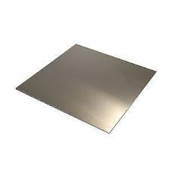
SHEET METAL
Sheet metal is used to make the collecting box.
Material - G I SHEET
Size - 40*15cm
Thickness - 3mm
Quantity - 1

Slide 12
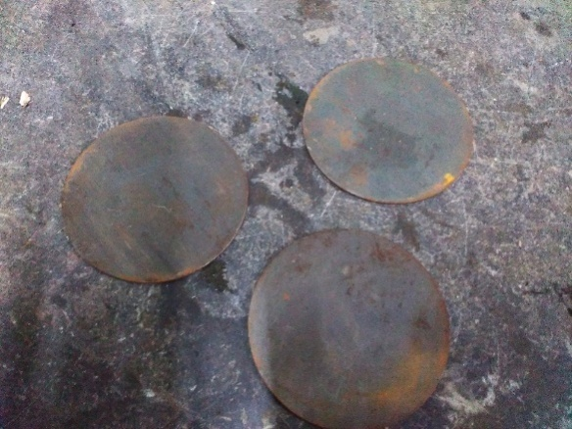
CIRCULAR DISC
Specifications:
Material: Mild steel
Outer diameter: 6 inch
Thickness: 3mm

Slide 13
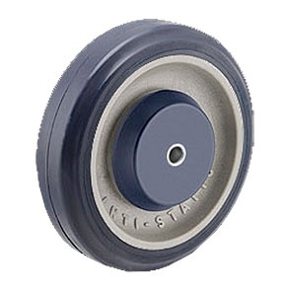
Wheel
Hub material: steel
Tire: PLASTIC

Slide 14
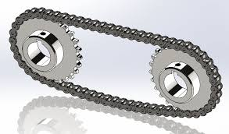
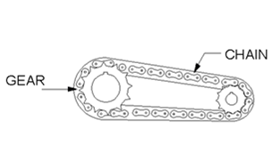
CHAIN DRIVE
Chain drive is a way of transmitting mechanical power from one place to another. It is often used to convey power to the wheels of a vehicle, particularly bicycles and motorcycles.
he power is conveyed by a roller chain, known as the drive chain, passing over a sprocket gear, with the teeth of the gear meshing with the holes in the links of the chain. The gear is turned, and this pulls the chain putting mechanical force

Slide 15
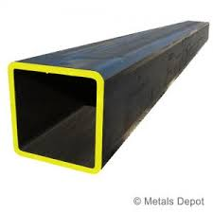
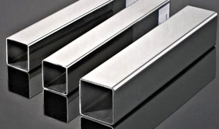
FRAME
Material: Mild steel

Slide 16
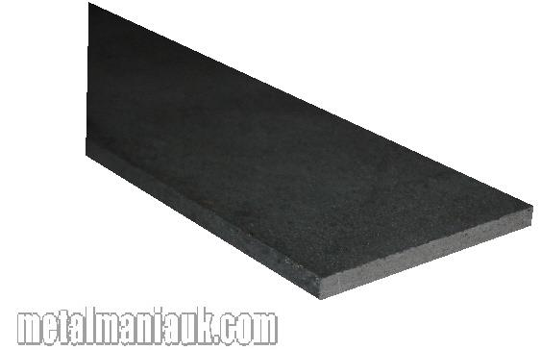
METAL STRIP
Specifications
Material: Mild Steel Strip
Length:40cm Width:5cm
Specifications
Length:60cm
Width:5cm

Slide 17
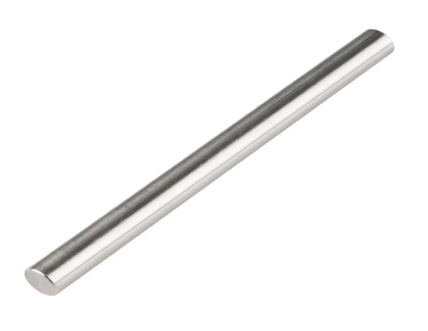
SHAFT
Shaft diameter: 12mm
Material: mild steel

Slide 18
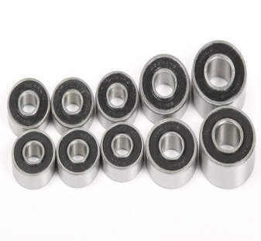
DESIGN OF BALL BEARING
A bearing is a machine element that constrains relative motion to only the desired motion, and reduces friction between moving parts. The design of the bearing may, for example, provide for free linear movement of the moving part or for free rotation around a fixed axis; or, it may prevent a motion by controlling the vectors of normal forces that bear on the moving parts

Slide 19
ADVANTAGES
Reduced fatigue and improvedergonomics.
Appropriateformanytypesofloads.
Reduced riskofaccidentsandinjurywhen.
Protection oftransportedgoods.
Increased productivity.
Hygienic benefits.
Easy t o maintain.
They can be fold edandstored easily.
Transportthe goods easily.
Initialc ostis more.

Slide 20
DIS ADVANTAGES
Loadcapacityisless.
NotsuitableforhighTemperaturesensitivity.
Notsuitableforheavyindustrialuse.
highforceneededtopushorpullthetrolley.
surfaceonlysuitableforflatroad.
cannotloadmanythings.
unstableforheavydutywork.

Slide 21
APPLICATION
Transporting odd-shaped good.
Using in shopping Mahals.
Using in hospital.
Using in auto mobile industry.

Slide 22
MATERIAL USED
S.No | DESCIRPTION | QTY | MATERIAL
1. | CHAIN DRIVE | 1 | STAINLESS STEEL
2. | FRAME | AS PER REQUIRMENT | MILD STEEL
3.. | SHAFT | AS PER REQUIRMENT | MILD STEEL
4. | METAL STRIP | AS PER REQUIRMENT | MILD STEEL
5.. | BEARING | 8 | STAINLESS STEEL
6. | SHEET METAL | 1 | MILD STEEL
7. | DISC | 1 | MILD STEEL
8. | WHEEL | 1 | PLASTIC
9.
10.
11.
12
13.

Slide 23
COST ESTIMATION
S.No | DESCIRPTION | RATE
1. | CHAIN DRIVE | 900
2. | FRAME | 1500
3.. | SHAFT | 300
4. | METAL STRIP | 200
5.. | BEARING | 200
6. | SHEET METAL | 800
7. | DISC | 500
8. | WHEEL | 600
9. |  | 5000
10.
11.
12
13.

Slide 24
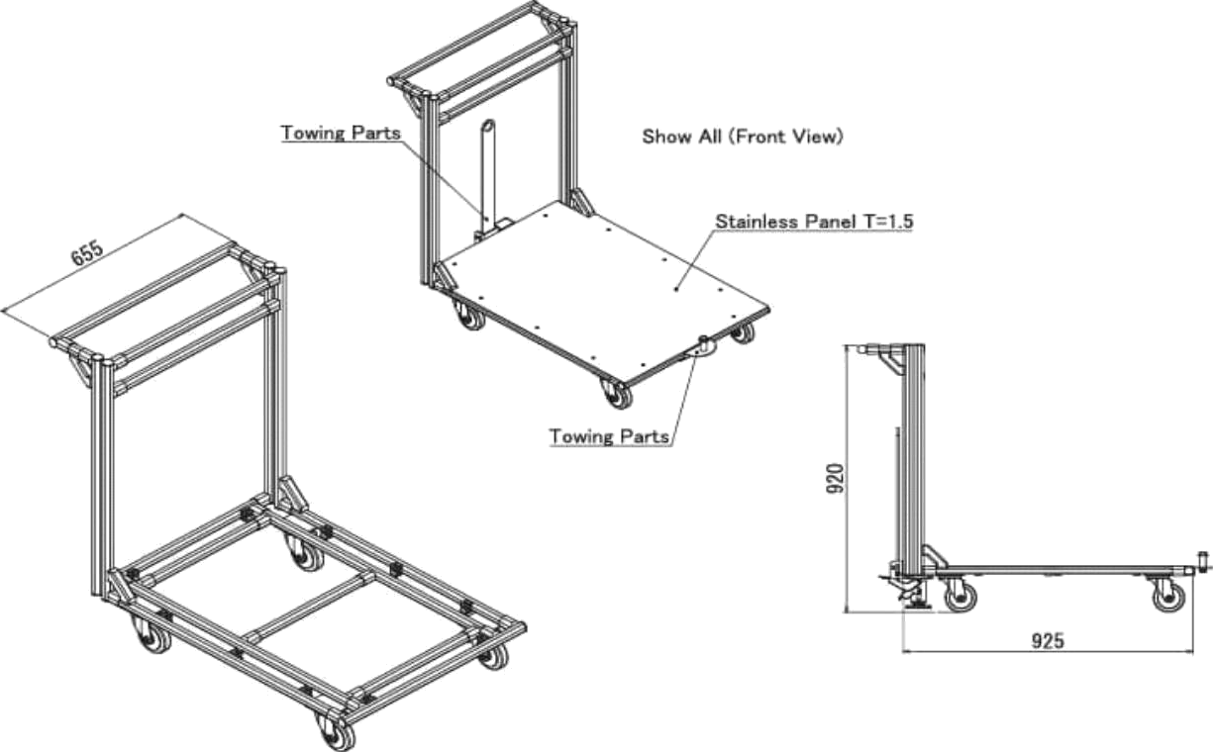
BLOCK DIAGRAM

Slide 25


